Slide 1
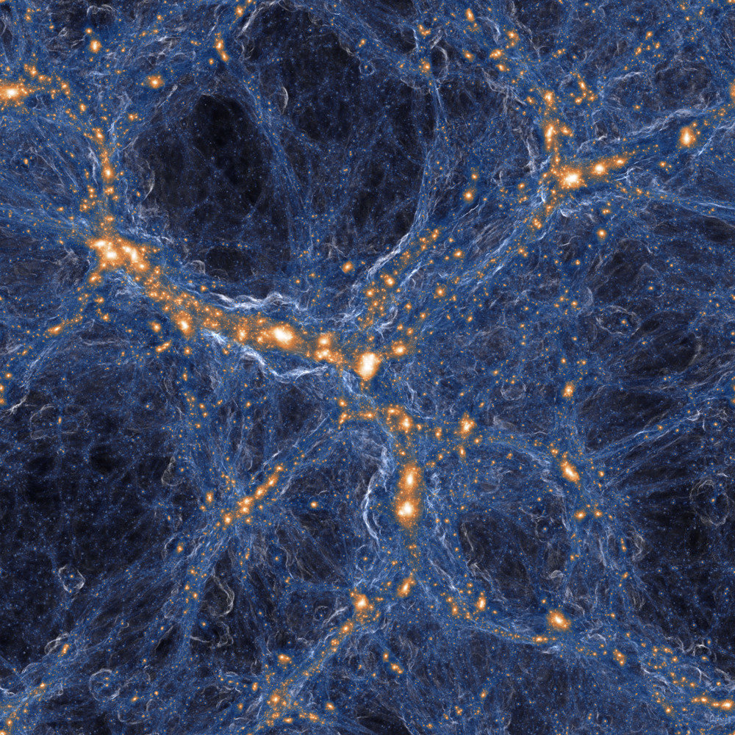
The Gas Diverges as a Fuel Mechanism for the Active Galactic Nucleus
By Emmanouil Karathanasis
E.Karathanasis-2015@hull.ac.uk
e.karathanasiss@gmail.com

Slide 2
Content
Introduction
Simulations
Methodology
Results
Discussion
Conclusion
Source: The IllustrisTNG Simulations: Public Data Release

Slide 3
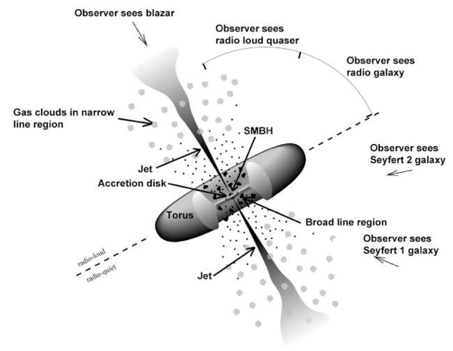
Introduction
What is an Active Galactic Nucleus:
Supermassive Black Hole
Luminous object
Immense amount of Energy
Type of Active Galactic Nucleus:
Seyfert galaxies
Blazars
Radio
Quasars
Source: https://fermi.gsfc.nasa.gov/science/eteu/agn/

Slide 4
Introduction
Kawata & Gibson (2005) research paper:
Elliptical galaxies
AGN heating mechanism
Self-regulated
Aims:
Construct a dataset
Determine whether gas divergence serves as a heating mechanism for the AGN.
Try to implanted to a predictive model

Slide 5
Simulations
Simulations
Illustris-1 and TNG100-1
Similarities:
Larges cosmological simulations of galaxy formation
Using the Λ-CDM paradigm
Data structure
Extra data for TNG:
Three more detailed runs
Large Black Hole mass seed

Slide 6
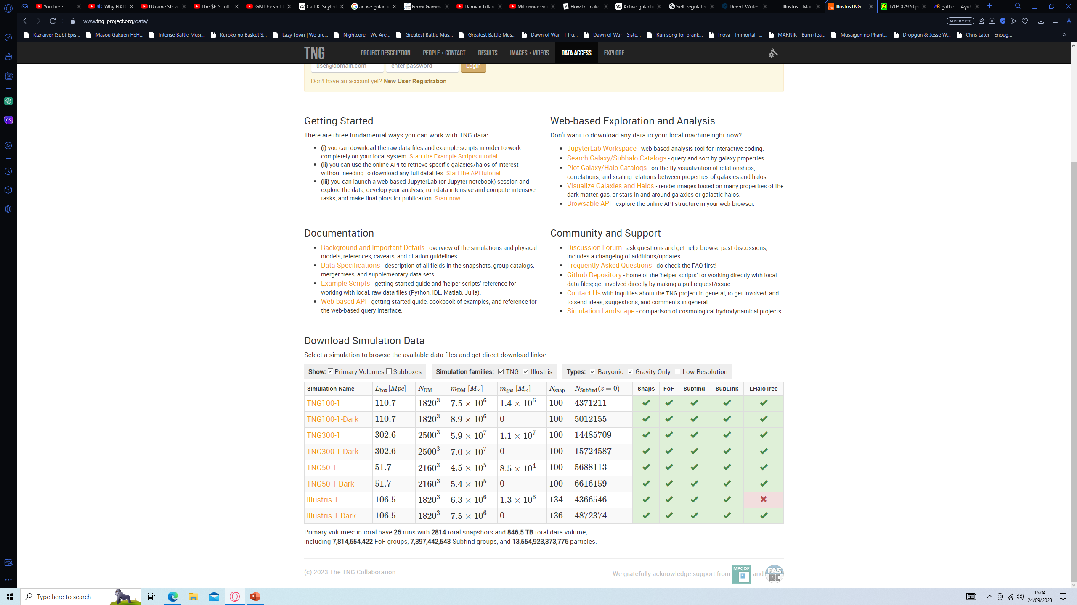
Simulations
Data
Three ways to access the data:
Download the snapshots or groupcats
API
JupyterLab
Selection criteria for the galaxies:
Three Galaxies from each simulation
One Black Hole
Most massive galaxies
Source: https://www.tng-project.org/data/

Slide 7








Methodology
The accretion rate of the Black hole:
Energy Feedback:
$e_{r}\text{ = 0.1 }$ for Illustris
$e_{r}$ = 0.2 for TNG
$$\frac{{\dot{M}}_{Bondi}}{{\dot{M}}_{Edd}}≥χ$$
$\frac{L_{bol}}{L_{Edd}}$ = $λ$
$$Δ{\dot{E}}_{low}=e_{f, kin}\dot{M}c^{2}$$
$$Δ{\dot{E}}_{high}=e_{f}e_{r}\dot{M}c^{2}$$
$e_{f, kin}$ = 0.2
$e_{f}$ = 0.1
Luminosities:
Gas Velocities
Divergence velocity
Radial velocity
$$L_{bol}=e_{r}\dot{M}c^{2}$$
$$L_{Edd}=e_{r}{{\dot{M}}_{Edd}c}^{2}$$

Slide 8
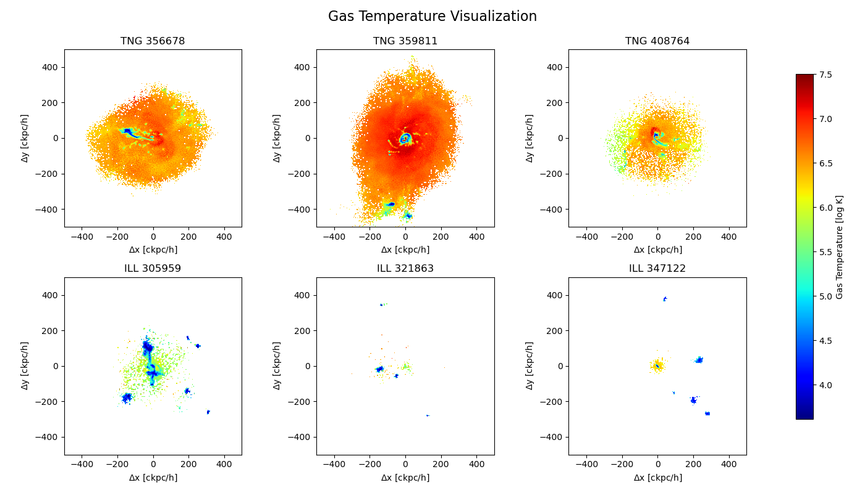
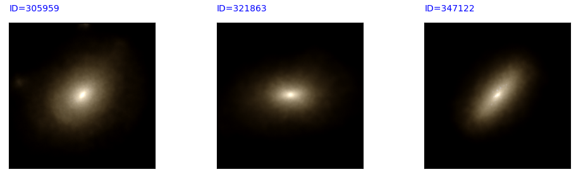
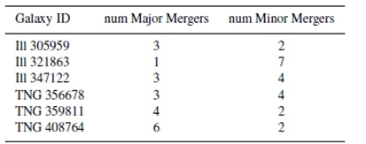
Methodology
Additional Data:
The mass of their Black Holes
Star Formation Rate
Energy injected in quasar mode
Energy injected in radio mode
Their Merges
Morphologies
Predictive Data

Slide 9
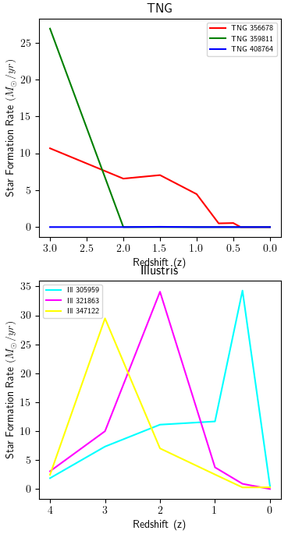
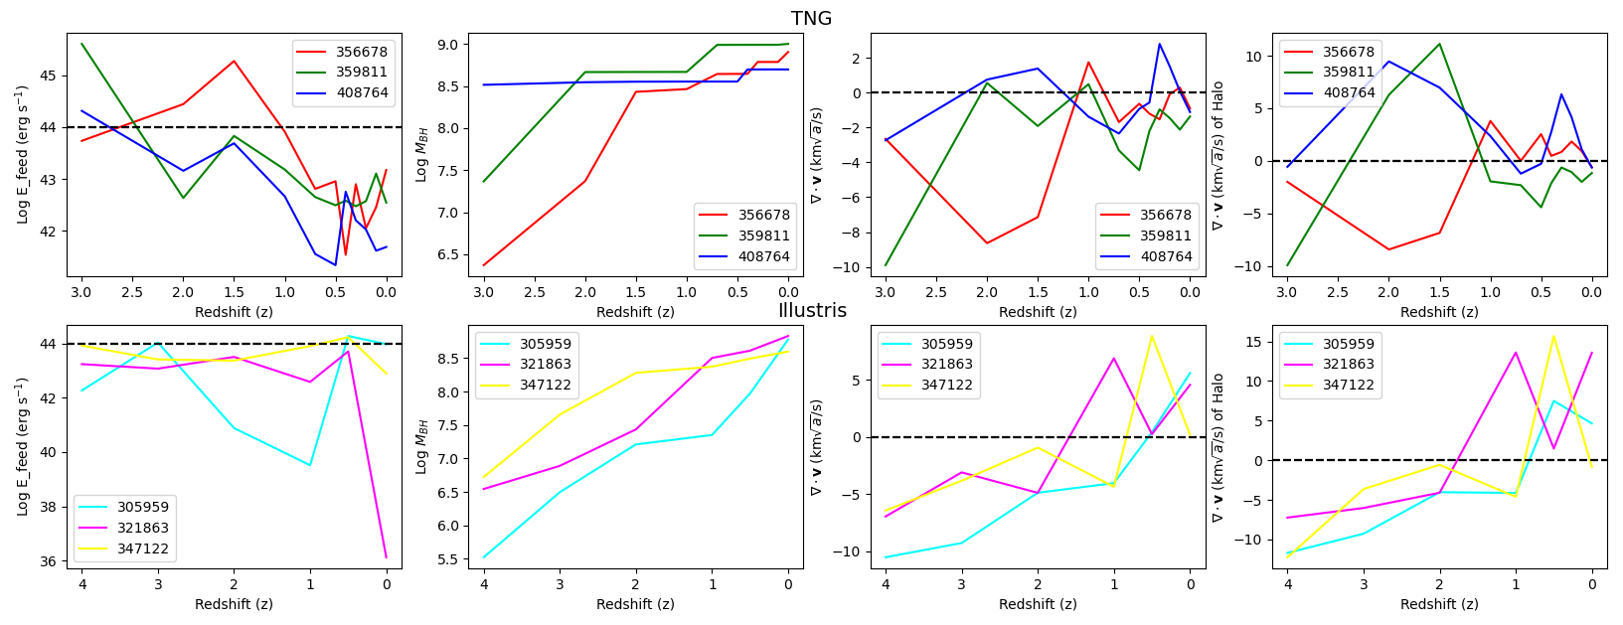
Results
Initial analyses for the six galaxies:
Star Formation Rate
Velocities
Energy Feedback
Black Hole mass growth

Slide 10
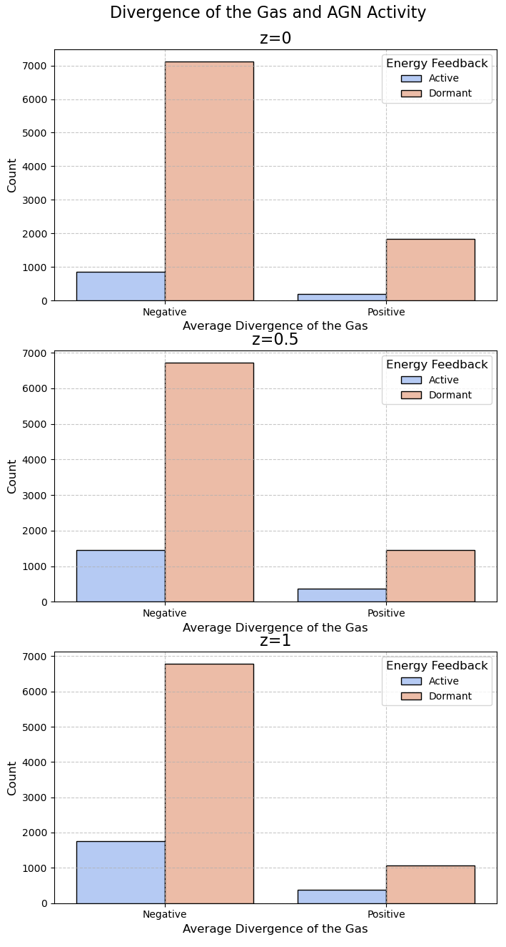
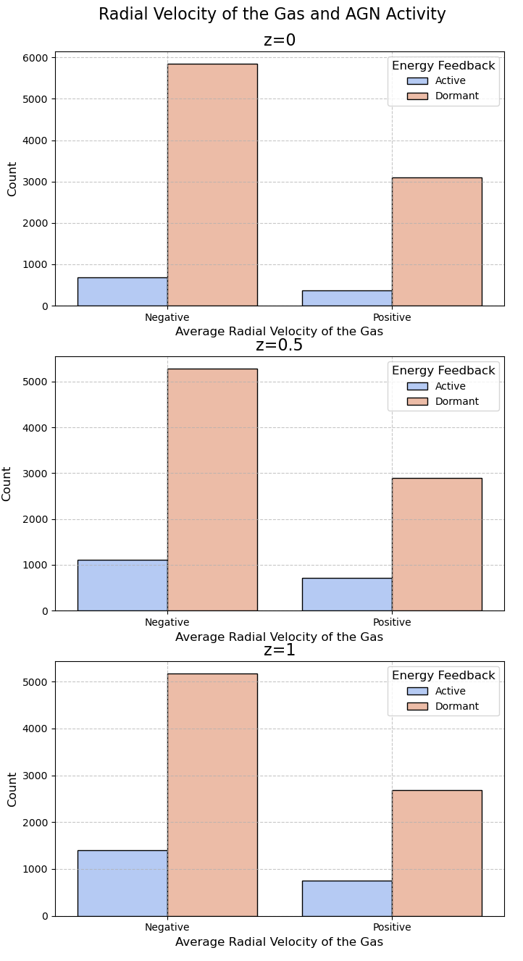

Results
Predictive Data:
Divergence of the Gas and AGN Activity
Radial Velocity of the Gas and AGN Activity
Initial accuracies:
Logistic Regression: 83.15%
Decision Tree and Random Forest: 83.15%
Imbalance classifier: 66.7%
Accuracies with $\dot{M}$:
Logistic Regression and Decision Tree: 98.26%
Neural Network: 98.26% (over-fitting problem)

Slide 11

Discussion
Initial analyses:
TNG Galaxies validates the theory
Illustris Galaxies do not validate it
Further analyses:
The predictive model fails to prove the theory
$\dot{M}$

Slide 12

Conclusion
Conclusion:
The study fails to prove the theory
$\dot{M}$
Merges
Divergence and radial velocities of the gas alone are insufficient for prediction
Limitations:
No grand unification theory of AGN
Gaps in our understanding of AGN

Slide 13
Thank You
Q & A section

